Slide 1




Understanding Attrition
TRISHA WINQUIST
2/15/2025
BELLEVUE UNIVERSITY

Slide 2





BUSINESS PROBLEM
Predicting Employee Attrition to Enhance Retention Strategies and Improve Organizational Performance
Retention Strategies
Data Analysis
Engagement Initiatives
What are the key factors influencing employee attrition?
Can we predict which employees will leave in the next 6 months?
How does work life balance affect employee retention?

Slide 3


THE IMPORTANCE OF DATA ANALYSIS FOR HR ATTRITION
Data analysis is essential for addressing HR attrition. It helps organizations understand the underlying causes of turnover, make informed decisions about retention strategies, and ultimately create a more engaged, satisfied, and loyal workforce. By leveraging data, companies can reduce attrition rates, improve employee satisfaction, and ensure long-term organizational success.

Slide 4



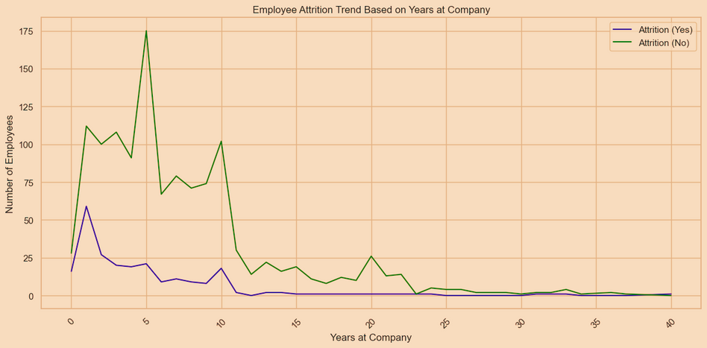
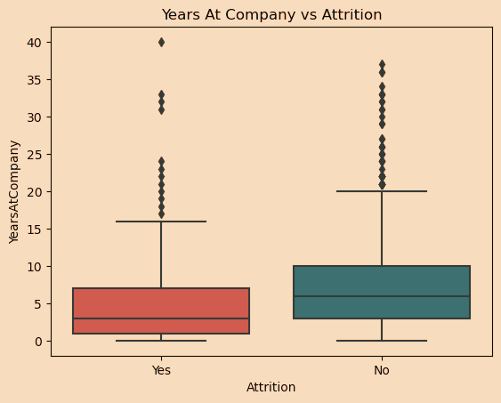
Attrition based on Years at Company
High attrition in the first few years may indicate challenges with retention strategies for new hires or the adjustment process.
Stable or decreasing attrition in later years suggests that employees who stay longer are less likely to leave, likely due to job satisfaction, stability, or seniority.

Slide 5


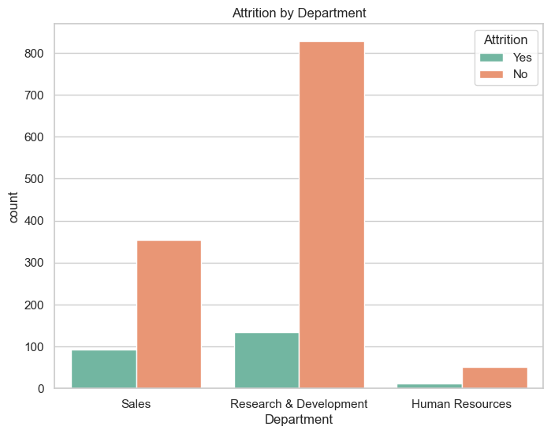
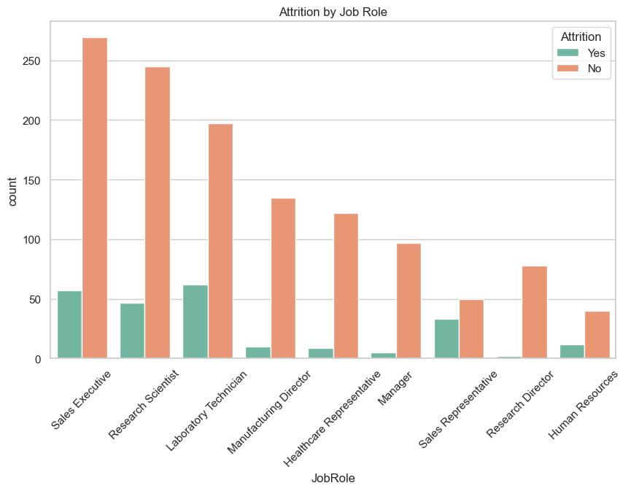
Attrition by Job Role
Attrition by Department

Slide 6


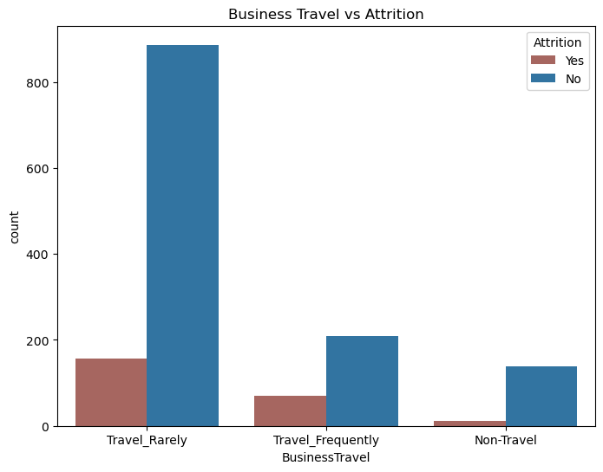
Attrition by Business Travel
Attrition Trends
Data Overview
The line graph illustrates monthly attrition rates over the past year, highlighting notable spikes during specific months. Projections suggest trends may continue if proactive measures are not implemented.

Slide 7

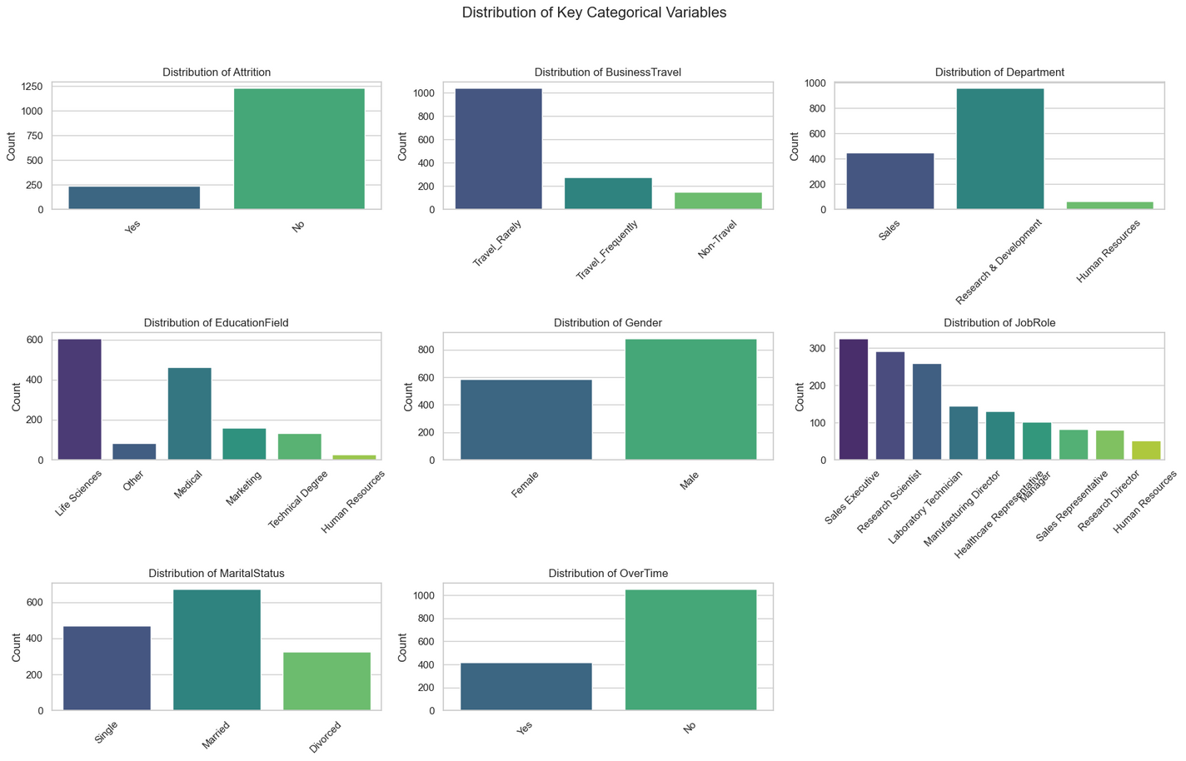

Distribution of Key Categorical Variables
The distribution of categorical variables in the HR attrition dataset reveals key workforce patterns. Most employees do not leave the company, indicating relatively low attrition. The majority travel rarely for business, while only a small portion travel frequently or not at all. Research & Development is the largest department, followed by Sales, with Human Resources having the fewest employees. Life Sciences and Medical are the most common education fields, while Marketing, Technical Degrees, and HR are less represented. The workforce consists of more males than females. Among job roles, Sales Executives, Research Scientists, and Lab Technicians are the most common, whereas HR, Sales Representatives, and Research Directors are the least frequent. In terms of marital status, married employees are the largest group, followed by single employees, with divorced employees forming the smallest group. Most employees do not work overtime, though a smaller segment does, which may be linked to attrition.

Slide 8


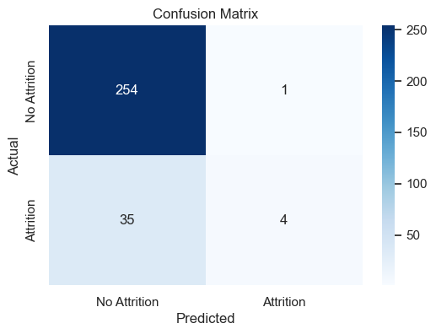

Predictive Analysis: Employee Attrition Modeling
Accuracy: 88% (Model correctly predicts attrition 88% of the time)
F1-score (Attrition): 18% (Low recall suggests the model struggles to detect attrition cases).
Recall (1 - Attrition cases): 10% (The model only catches 10% of actual attrition cases).
Precision (1 - Attrition cases): 80% (When the model predicts attrition, it is correct 80% of the time).

Slide 9
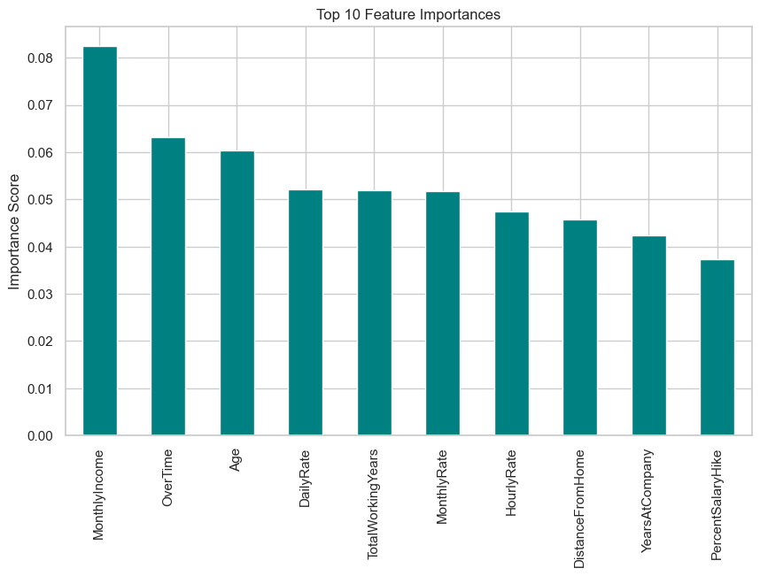
Top 10 Feature Importance
Monthly Income
Overtime
Age
Daily Rate
Total Working years
Hourly rate]
Distance from home
Years at company

Slide 10

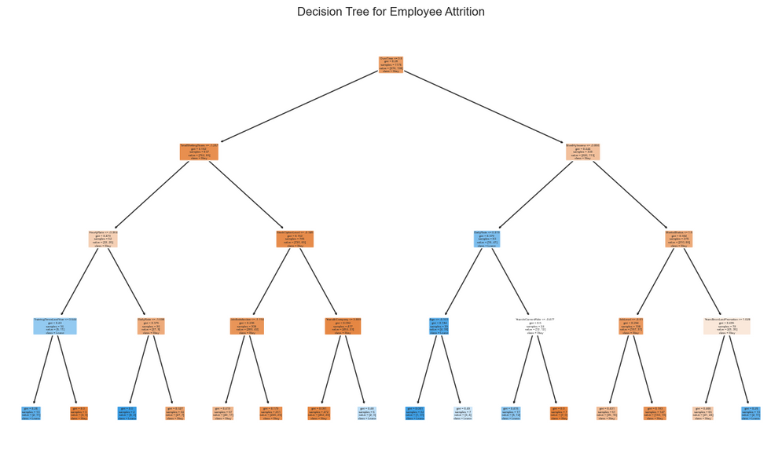
Decision Tree illustrating key factors influencing employee attrition. OverTime, Job Satisfaction, and Work-Life Balance play significant roles
Employees working Overtime are more likely to leave.
Low Job Satisfaction and Work-Life Balance are strong risk indicators.
Monthly Income also plays a role—lower salaries might increase attrition risk.
The tree correctly predicts most employees who stay.
However, it struggles with recall (identifying employees who will leave).
Focus on work-life balance initiatives to reduce overtime pressure.
Improve job satisfaction programs to retain talent.
Consider salary adjustments or benefits to retain employees at risk.

Slide 11



Ethical Implications
When using data for HR attrition prediction and analysis, there are important ethical considerations to address to ensure fairness, transparency, and responsible use of insights.
Bias and Fairness-A predictive model trained on biased data may reinforce discrimination rather than reduce attrition fairly.
Employee Privacy and data security- Data breaches or improper handling can violate employee privacy rights
Transparency and employee trust-If employees feel they are being monitored unfairly, it could damage trust and morale
Ethical Decision-Making-Could result in unethical decision-making, such as preemptively reducing opportunities for employees flagged as likely to leave.
Accountability & Legal Considerations- Could create legal risks (e.g., wrongful termination claims, discrimination lawsuits)

Slide 12

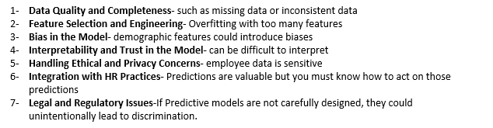
Challenges/Issues

Slide 13

Conclusion
The Future of Data Analysis for HR Attrition
As organizations continue to evolve, data-driven approaches will play an increasingly vital role in managing and reducing employee attrition. Predictive analytics and machine learning models will enable HR teams to identify early warning signs of turnover, allowing for proactive retention strategies. By integrating external factors such as economic trends and industry benchmarks, companies can refine their workforce planning and improve employee satisfaction. Ethical considerations, including data privacy and bias mitigation, will be crucial in ensuring fair decision-making. The future of HR analytics lies in leveraging real-time data, personalized retention strategies, and AI-driven insights to create a more engaged and stable workforce.

